Slide 1
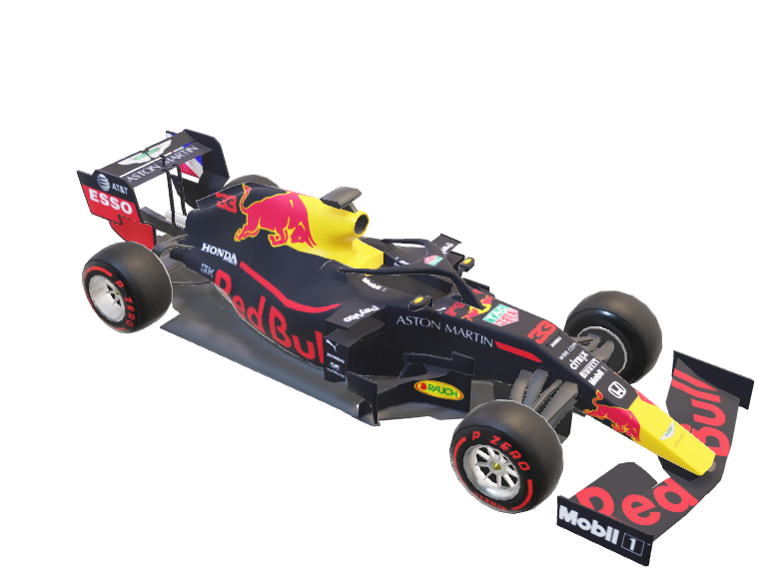

Slide 2

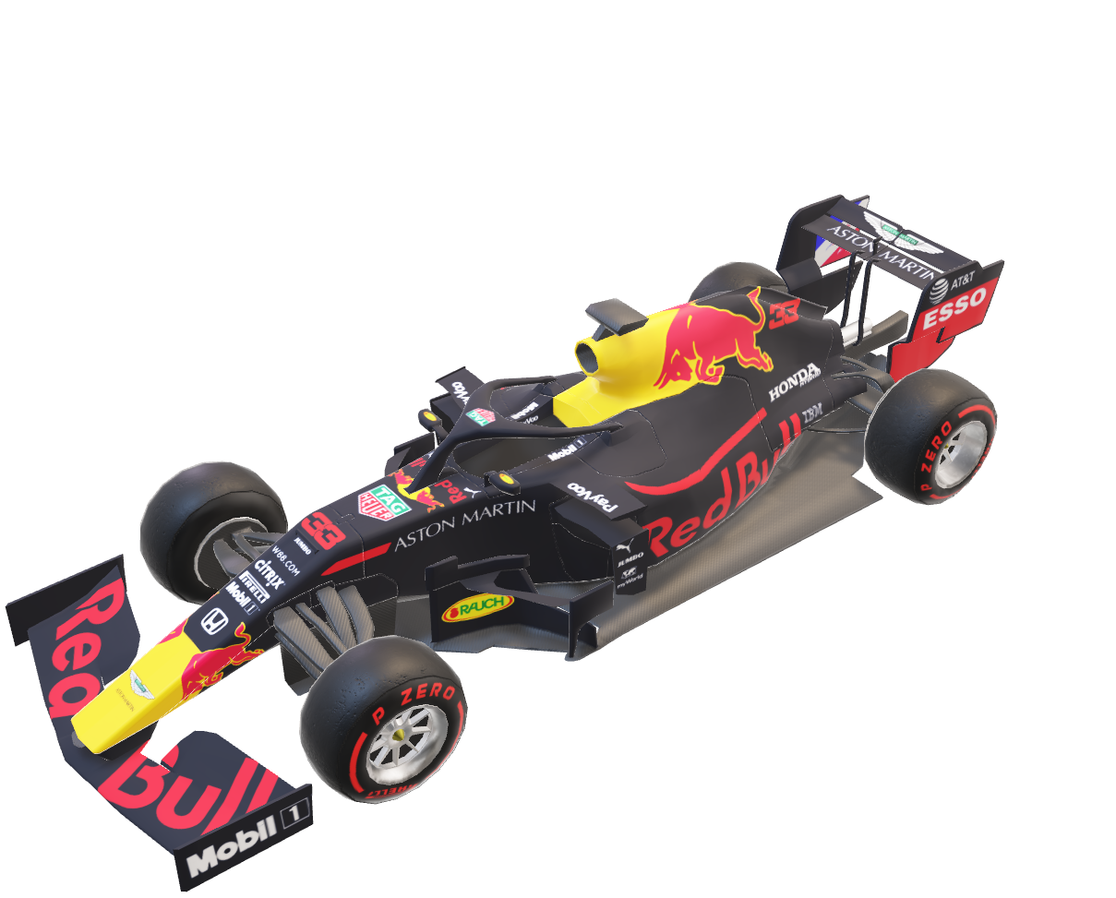
Lap Time Analysis

Slide 3

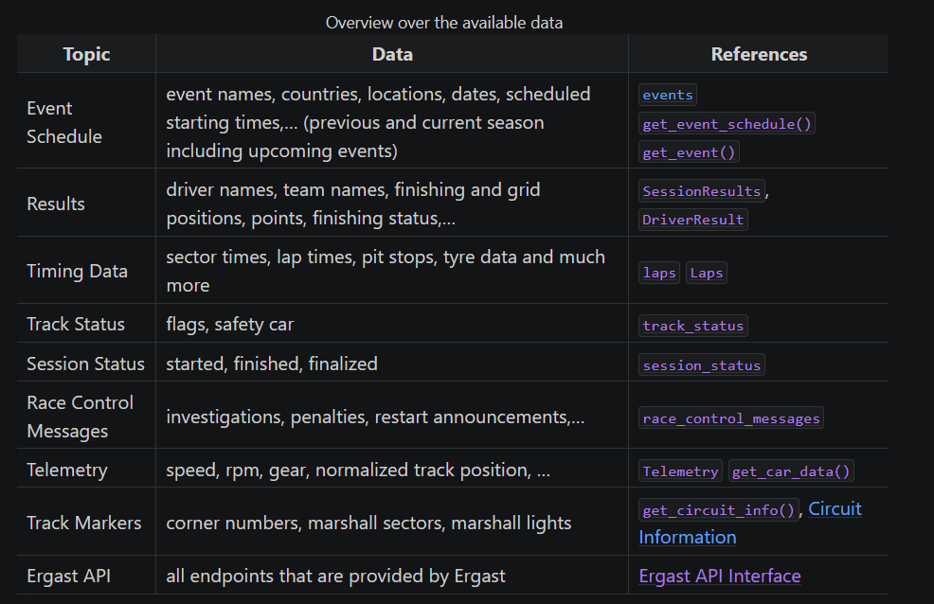
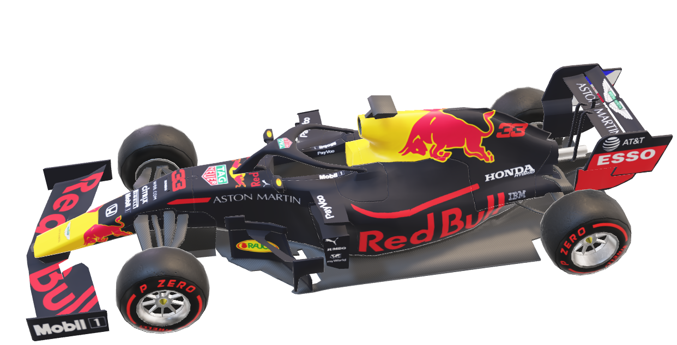
The Dataset

Slide 4
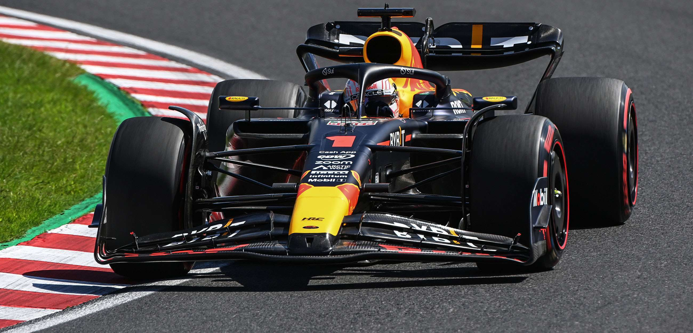
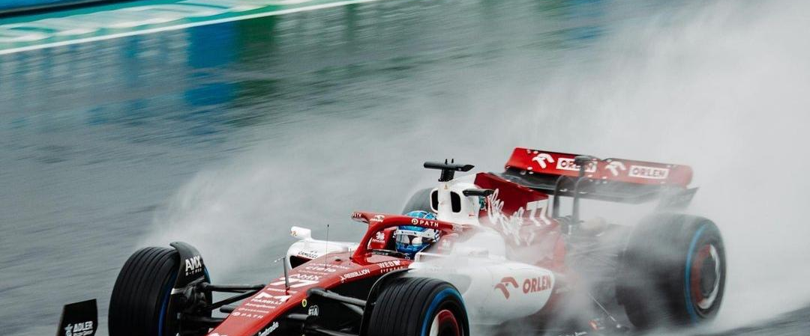
Research Question

Slide 5
Transformed Features
Total Lap Time - mean
Lap Number / Total Laps
Unchanged
[Soft, Medium, Hard, Intermediate, Wet]
Tyre Life / Total Laps
Unchanged
Lap Features
Total Lap Time
Lap Number
Stint
Tyre Compound
Tyre Life
Weather Features
Air Temperature
Track Temperature
Humidity
Air Pressure
Wind Speed
Rainfall

Slide 6
Telemetry Data
Time
Time
Time
Time
Time
Car Position (X, Y)
Car Position (X, Y)
Car Position (X, Y)
Car Position (X, Y)
Car Position (X, Y)
Corner Apex Points (X, Y)
Corner Apex Points (X, Y)

Slide 7
Telemetry Data
Time
Car Position (X, Y)
Corner Apex Points (X, Y)
Mean Corner Exit Speed
Corner Apex Points (X, Y)
Car Position (X, Y)
Time
Car Position (X, Y)
Curvature
Time
Car Position (X, Y)
Acceleration
Time
Lateral Acceleration
Car Position (X, Y)
Time

Slide 8
Telemetry Data Filtering
Fit a Smoothing Spline
on X and Y

Slide 9
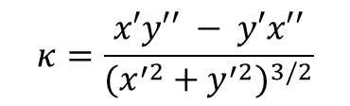
Telemetry Data Filtering
Fit a Smoothing Spline
on X and Y
Calculate Curvature with Spline Derivatives
$$κ=\frac{x′y′′ − y′x′′}{{(x^{′2}+y^{′2})}^{3/2}}$$

Slide 10
Telemetry Data Filtering
Median Filter
Fit a Smoothing Spline
on X and Y
Calculate Curvature with Spline Derivatives
Moving Average
$$κ=\frac{x′y′′ − y′x′′}{{(x^{′2}+y^{′2})}^{3/2}}$$

Slide 11
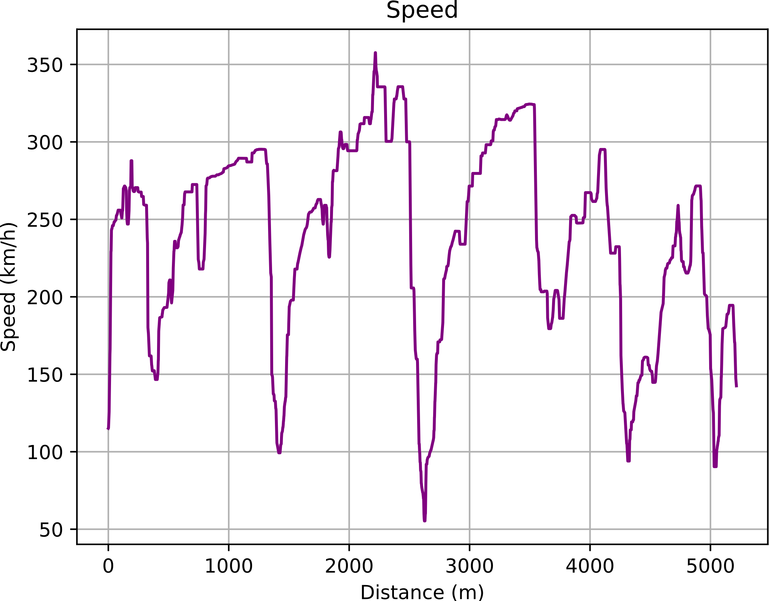
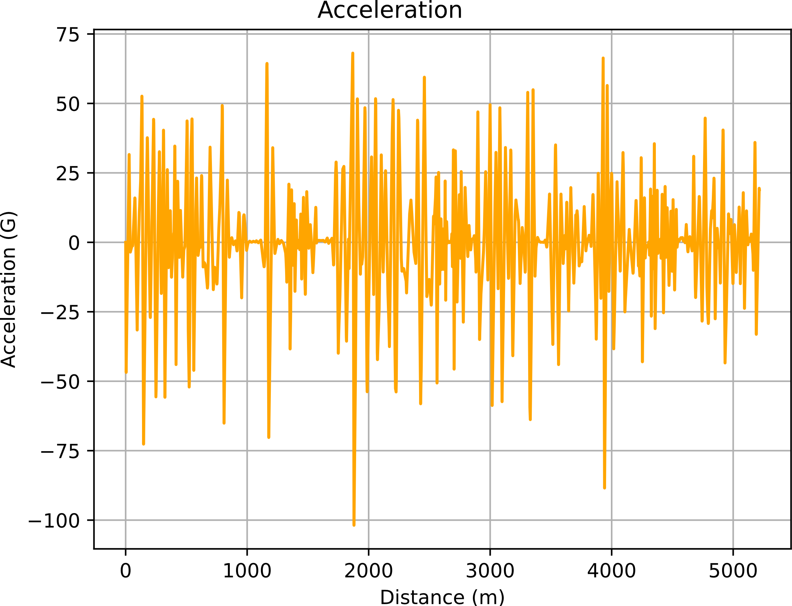
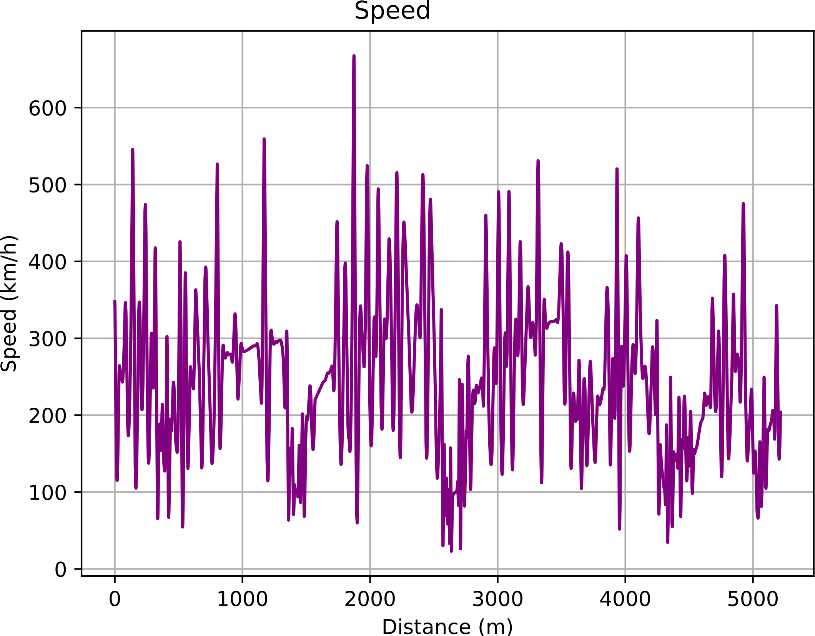
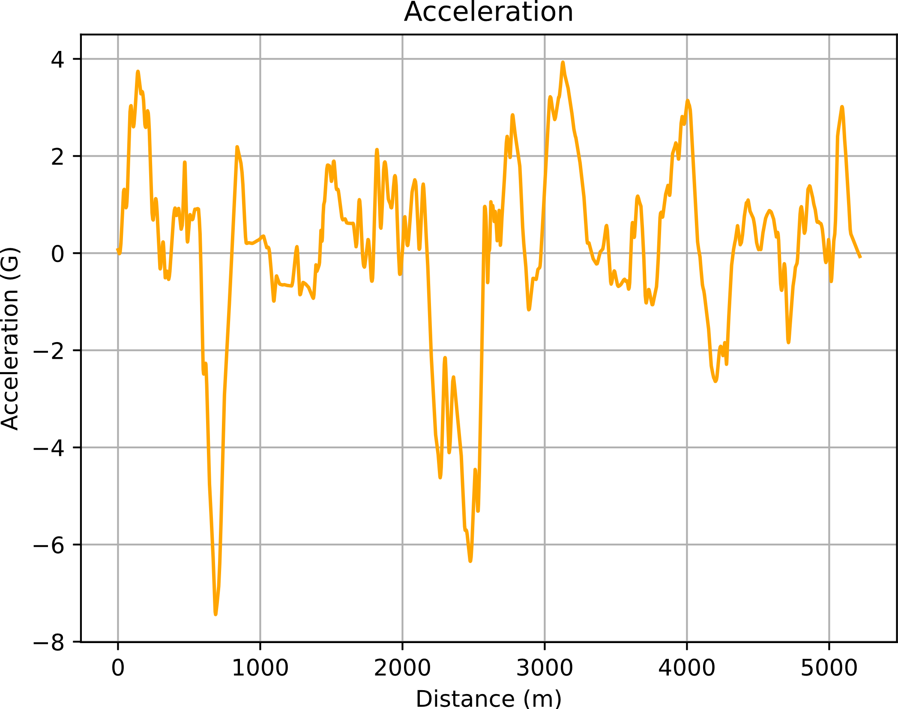

Slide 12
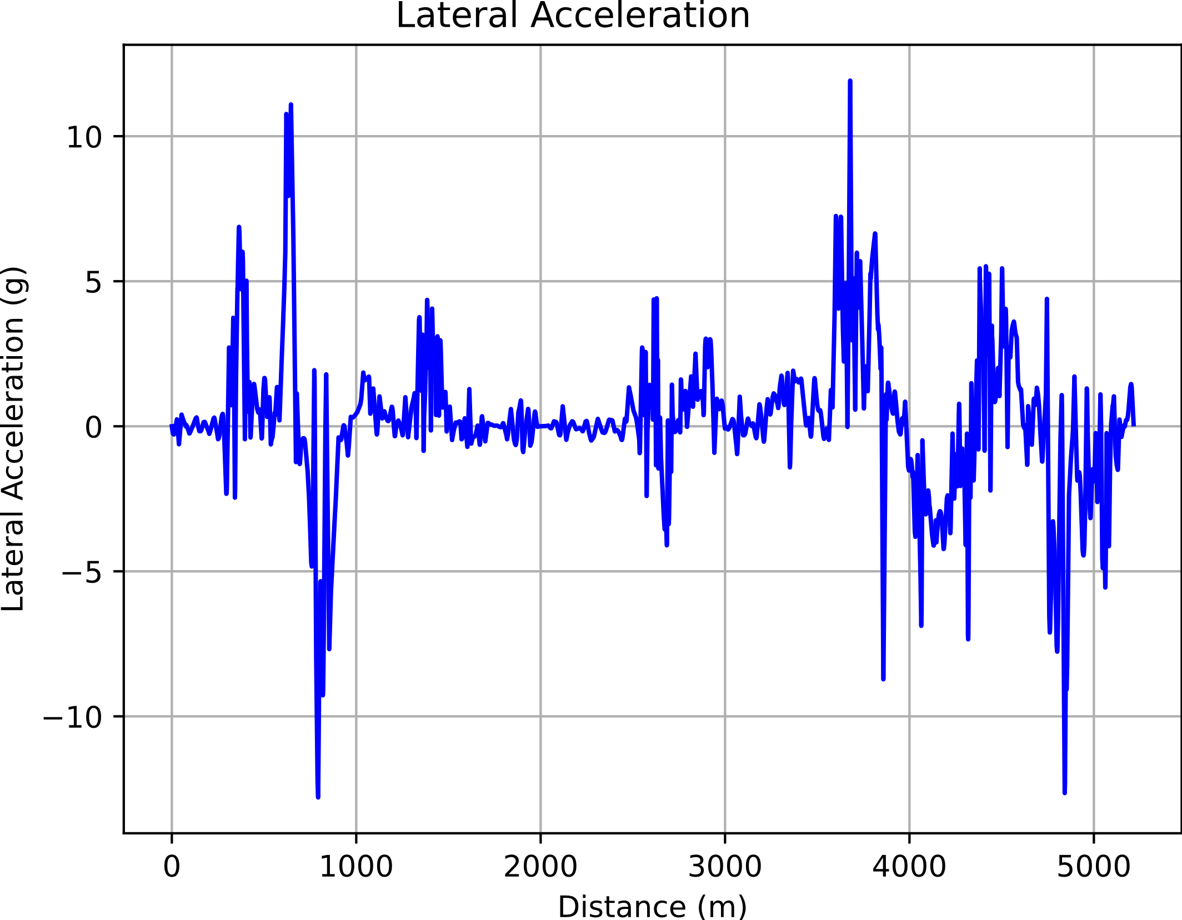
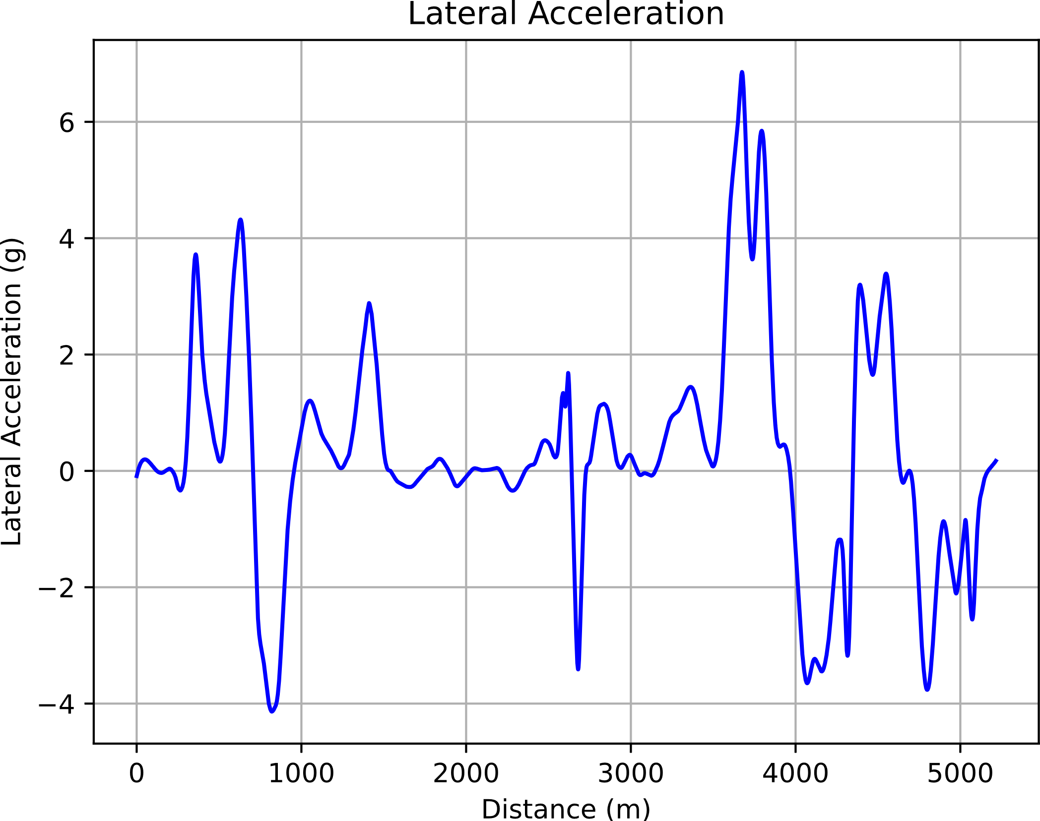
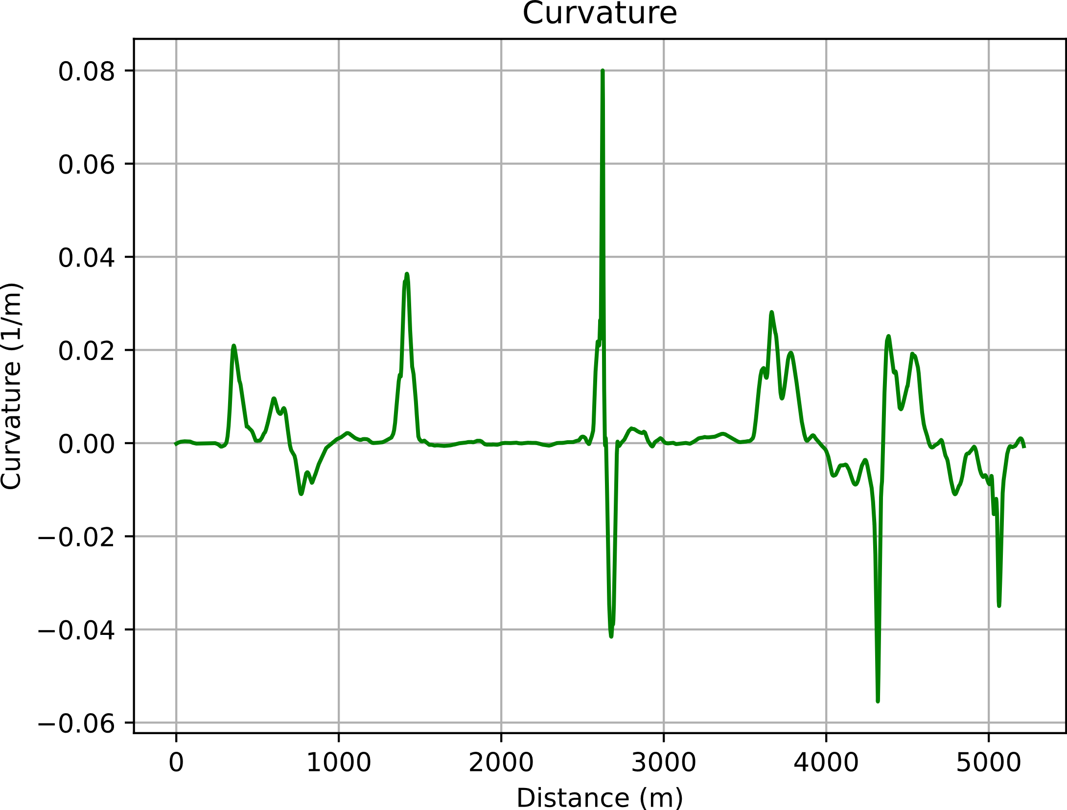
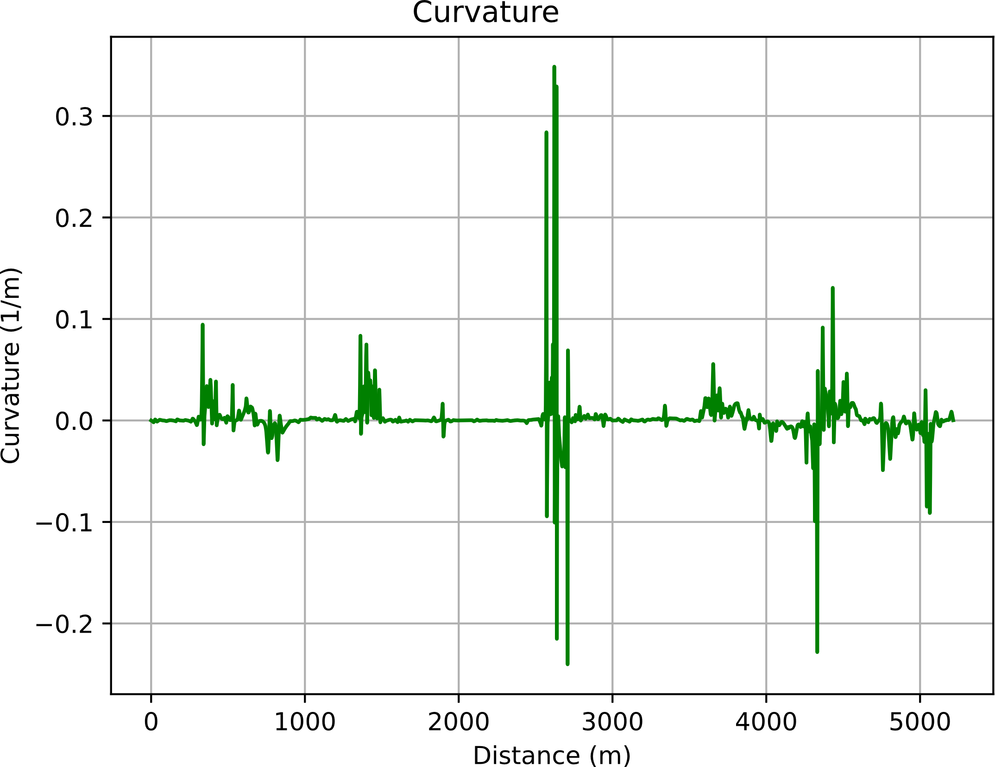

Slide 13
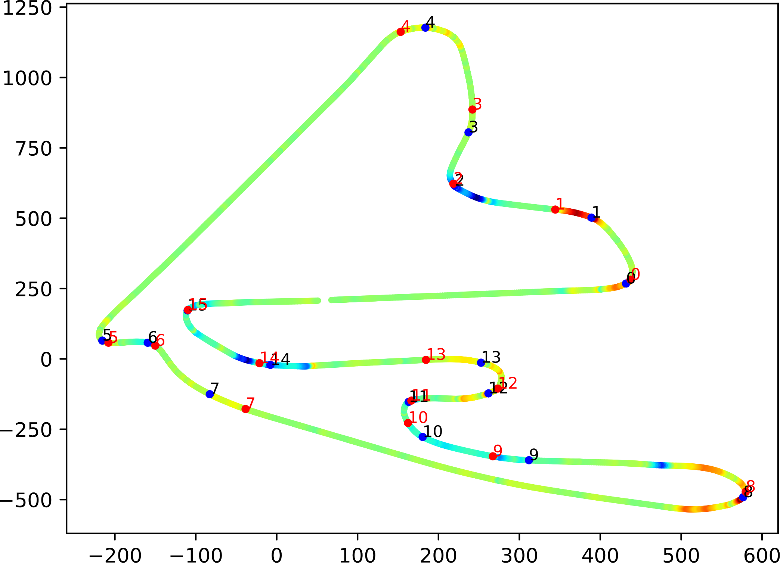

Slide 14
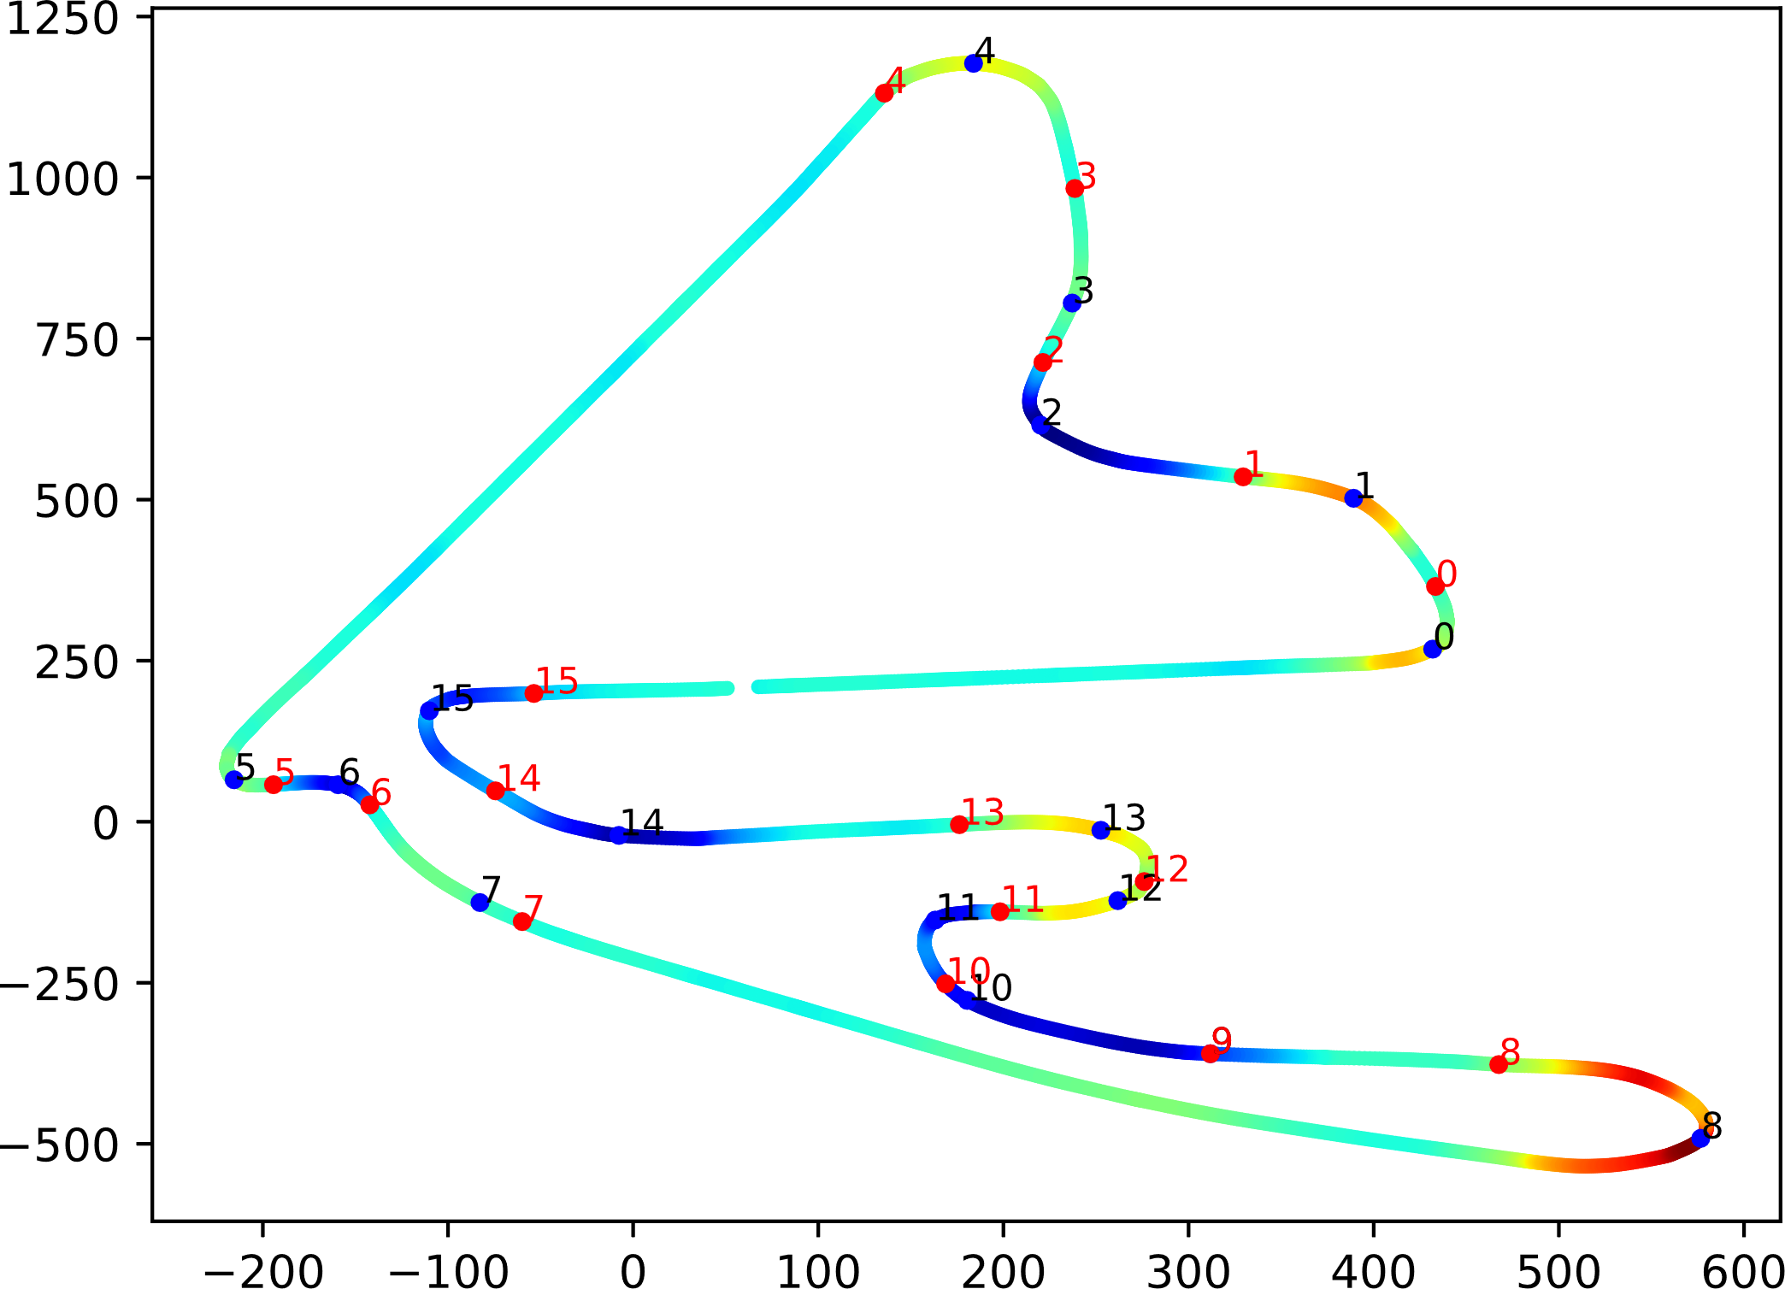

Slide 15
Final Features
Lap Number
Pressure
Air Temperature
Humidity
Mean Corner Exit Speed
Tyre Life
Track Temperature
Mean Curvature
Acceleration
Mean Curvature Difference
Wind Speed
Stint
Compounds (Soft, Med., Hard, Int., Wet)
Dataset Splitting
Dry
(50k samples)
Wet
(10k samples)

Slide 16
Final Features
Lap Number
Pressure
Air Temperature
Humidity
Mean Corner Exit Speed
Tyre Life
Track Temperature
Mean Curvature
Acceleration
Mean Curvature Difference
Wind Speed
Stint
Compounds (Soft, Med., Hard, Int., Wet)
Dataset Split
Dry
(50k samples)
Wet
(10k samples)

Slide 17
Model Training
80%
20%
Train
Test
Choose Hyperparameters
10-Fold CV
Choose Hyperparameters
Testing

Slide 18
Model Training
80%
20%
Train
Test
10-Fold CV
10-Fold CV
Choose Hyperparameters
Testing
Choose Hyperparameters

Slide 19
Model Training
80%
20%
Train
Test
10-Fold CV
Choose Hyperparameters
Testing
Testing
Choose Hyperparameters
10-Fold CV

Slide 20
Model Training
80%
20%
Train
Test
10-Fold CV
Choose Hyperparameters
Testing
Choose Hyperparameters
Testing
10-Fold CV

Slide 22
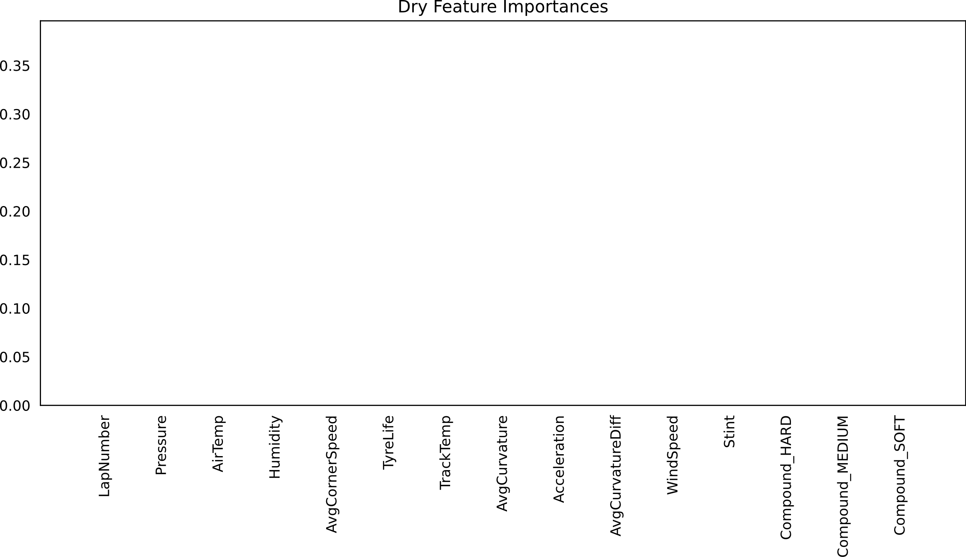
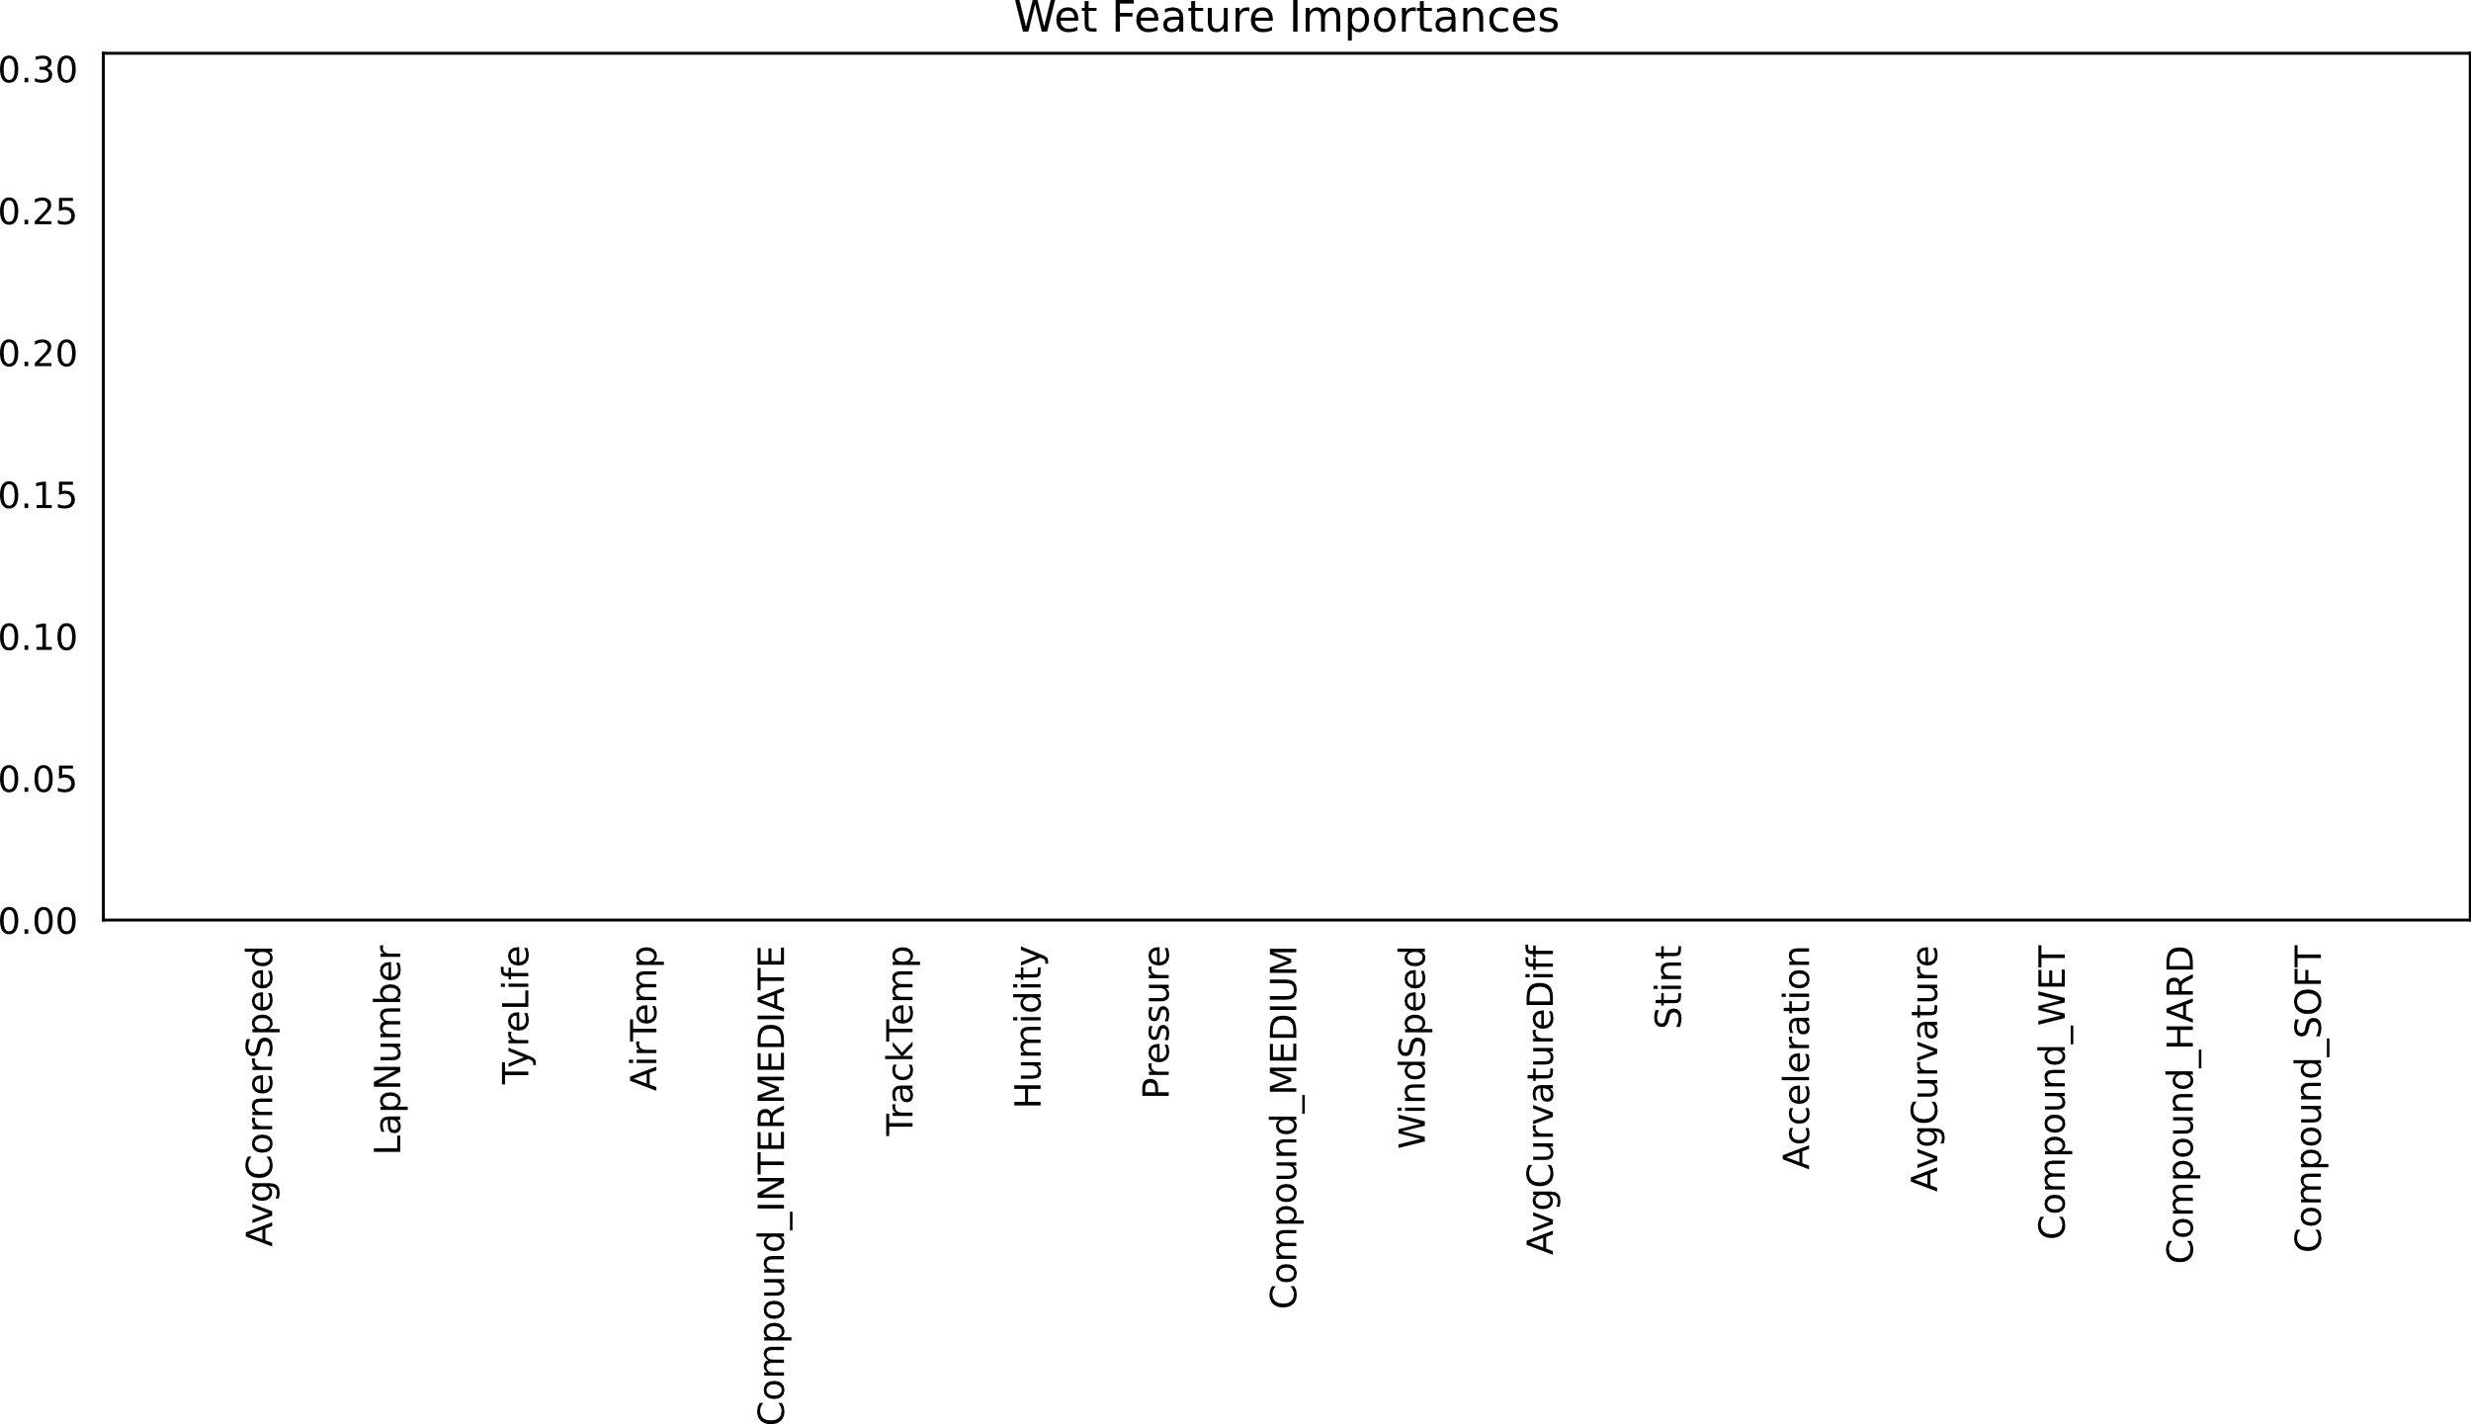



Slide 23
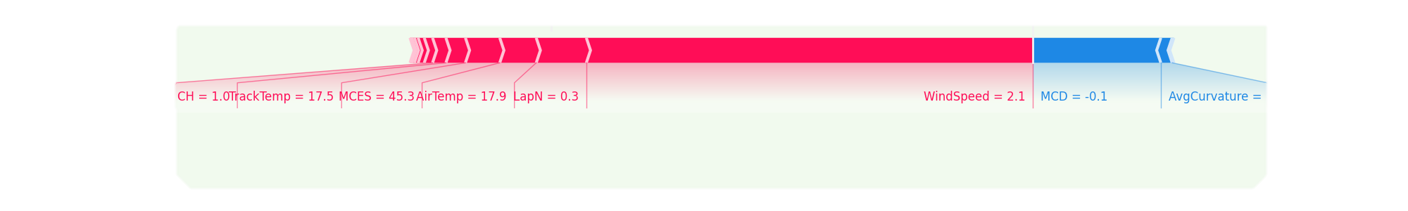
What is SHAP?

Slide 24


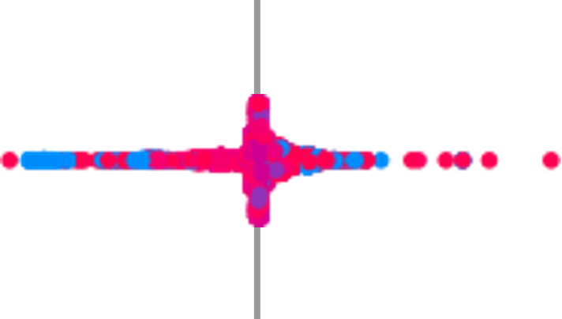











Dry Features Importances
Wet Features Importances
Lap Number
Lap Number
Air Pressure
Air Pressure
Air Temp
Air Temp
Humidity
Humidity
Compound_INTERMIDIATE
Mean C. Exit Speed
Mean C.
Exit Speed
Tyre Life
Tyre Life
TrackTemp

Slide 25
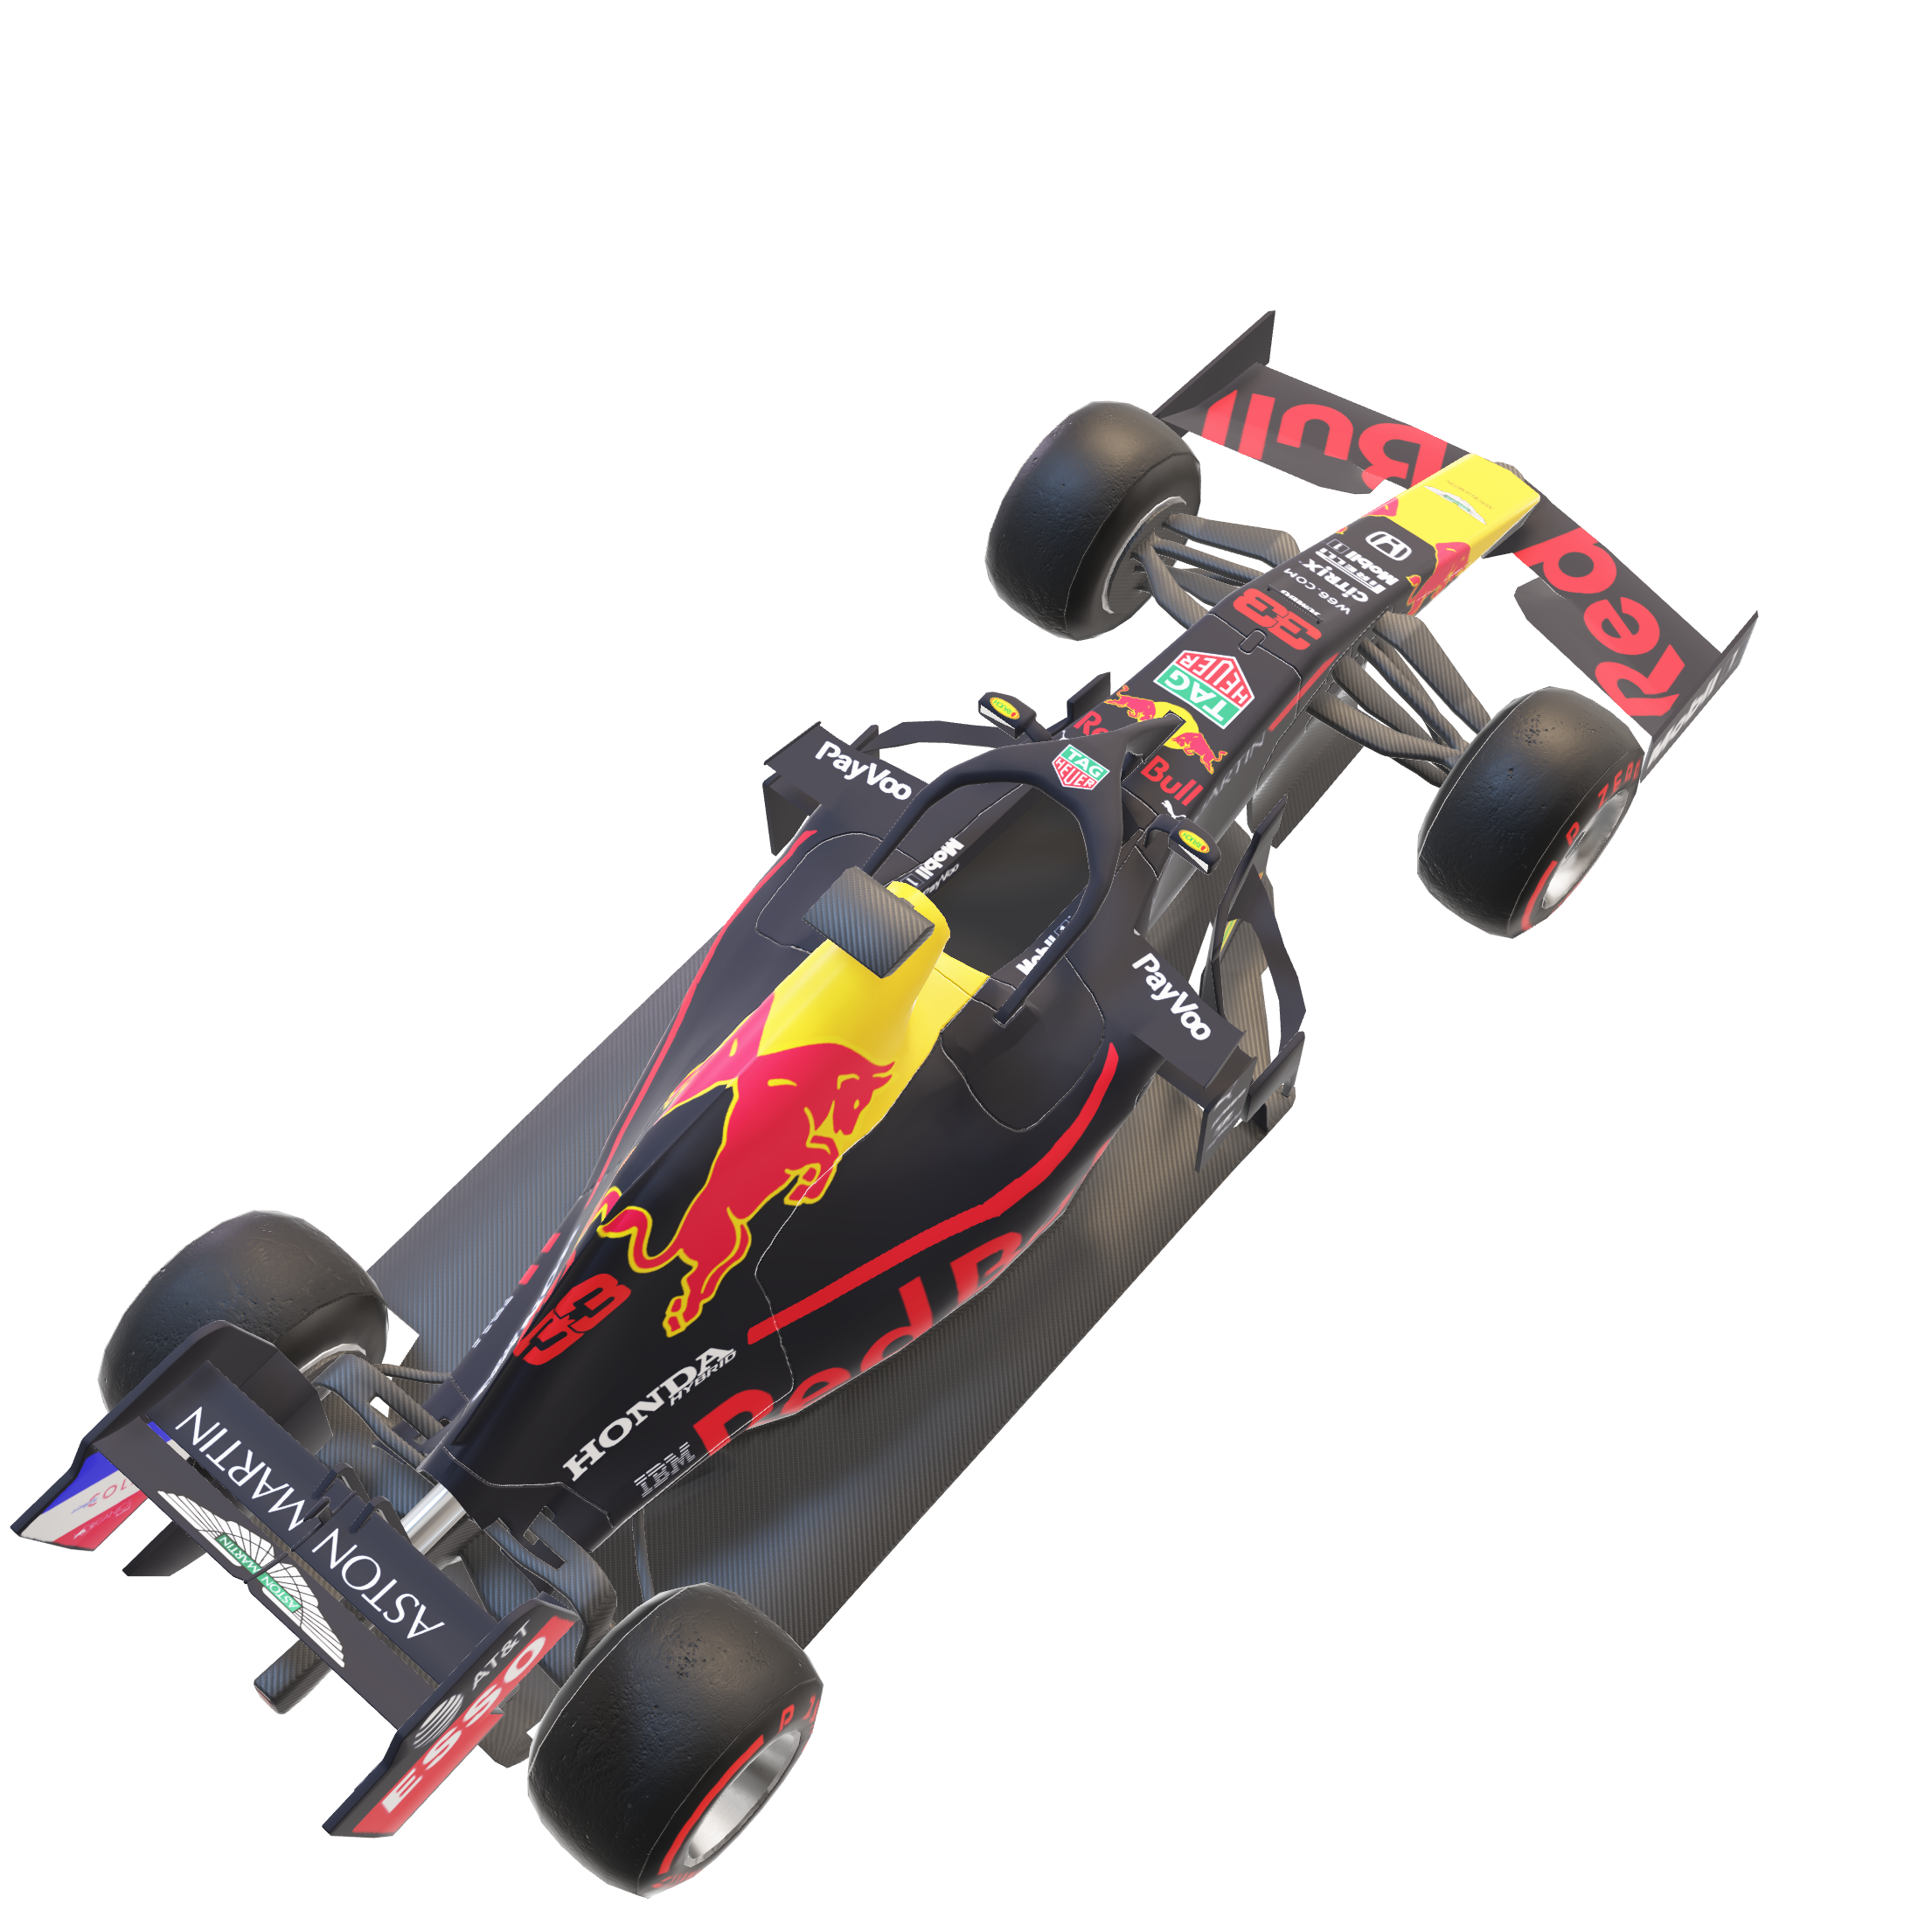
Dry Features Importances
Wet Features Importances
Lap Number
Mean C.
Exit Speed
Air Pressure
Lap Number
Air Pressure
Air Temp
Tyre Life
Humidity
Air Temp
Humidity
Compound_INTERMIDIATE
Mean C. Exit Speed
Tyre Life
TrackTemp

Slide 26
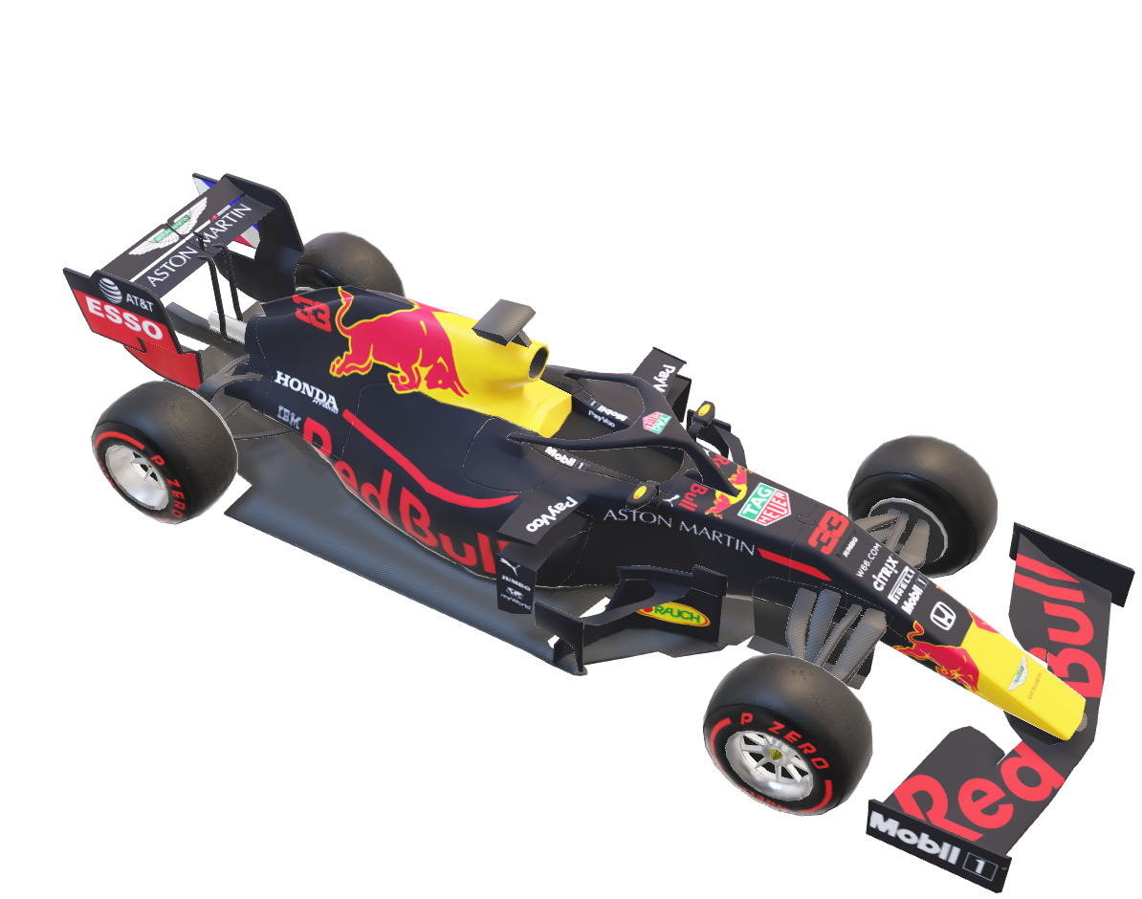
Conclusions

